Slide 1
Heterogeneous Wireless Networks
(Seamless Connectivity Across Diverse Networks)

Slide 2
Table of contents
01
Abstract
02
Literature Survey
Methodology && Implementation
03
04
Result && Discussion
05
Conclusion &&
Future Works
06
References

Slide 3
Abstract
01
The Role of Heterogeneous Wireless Networks

Slide 4
Introduction
Heterogenous Wireless Networks refers to a network architecture that integrates different types of wireless networks, such as cellular networks, Wi-Fi, satellite communication, and Bluetooth, into a single integrated system. This integration allows for more efficient use of resources, improved coverage, and enhanced connectivity speeds.
This integrated system enable devices to switch between different types of networks without any effort, ensuring that users always have the best possible connection based on their location a the network conditions. The concept of Heterogenous wireless networks also plays key role in development of next-generation wireless technologies(Such as 5G).

Slide 5
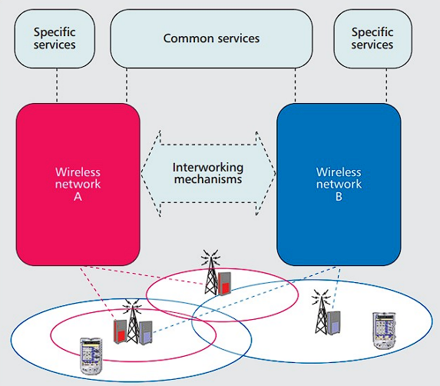
Internetworking
This diagram illustrates the integration of two distinct wireless networks, labeled Wireless Network A and B. Each network offers unique services, connected through interworking mechanisms that facilitate shared common services. The overlapping coverage areas demonstrate the seamless connectivity between these networks, ensuring comprehensive service provision across different zones.

Slide 6
Literature Survey
02
Exploring Heterogeneous Wireless Networks

Slide 7
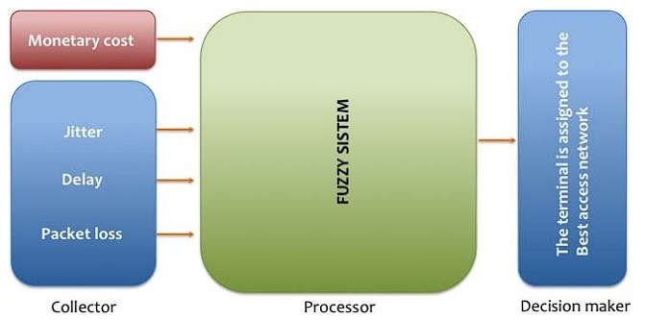
Network Selection Using Fuzzy Logic
Fuzzy Logic is a method that resembles human reasoning. It deals with reasoning that is approximate rather than fixed or exact. Unlike traditional Boolean logic where variables may only be 0 or 1 and True or False, Fuzzy logic variables may have a truth in handling between 0 and 1, representing the degree of truth.
“Network Selection Using Fuzzy Logic” involves utilizing fuzzy logic algorithms to enhance the decision-making process in wireless networks. This technique helps in dynamically selecting the optimal network based on various criteria like signal strength, user preferences, and network traffic. Fuzzy logic provides a more nuanced approach compared to traditional binary logic, enabling devices to make smarter, context-aware choices that improve user experience and network efficiency

Slide 8

Resource Allocation and Energy Efficiency in HWNs
Resource allocation in HWNs is critical for optimizing network performance and ensuring equitable access to network resources. This process involves distributing available bandwidth, computing power, and communication channels among users and applications efficiently. Effective resource allocation helps in managing the complexities of HWNs, where multiple network types and technologies coexist, ensuring that all users receive adequate network quality based on their needs and priorities.
Energy efficiency in HWNs is essential for reducing operational costs and environmental impact. It focuses on minimizing the energy consumption of network devices and infrastructures while maintaining service quality. Techniques such as dynamic power adjustment, energy-efficient routing, and sleep mode optimization are employed. These strategies help in extending the battery life of mobile devices and reducing the energy footprint of network operations, making HWNs more sustainable and cost-effective.

Slide 9
Load Balancing and Security Management in HWNs
Load balancing in Heterogeneous Wireless Networks (HWNs) is essential for distributing traffic evenly across various network resources to optimize performance and prevent any single device or link from becoming congested. By intelligently routing data traffic based on current network conditions, server capacities, and connection quality, load balancing ensures efficient utilization of resources, minimizes response times, and enhances the overall user experience in complex network environments.
Security management in HWNs addresses the diverse security challenges posed by multiple network standards and interfaces. It involves implementing robust protocols to safeguard data integrity, confidentiality, and availability across different network layers. Security measures include encryption, authentication, intrusion detection systems, and consistent security policy enforcement. These strategies are crucial to protect against threats and vulnerabilities in a multi-network architecture, ensuring secure and reliable communication.

Slide 10
Methodology && Implementation
03
Practical Strategies for Heterogeneous Wireless Networks

Slide 11
Simulation - 1

Slide 12
HWNs Network Selection Using Fuzzy Logic and AHP methods
Network Characteristics (inputs):
delay(ms): Time taken for data packets to travel from source to destination.
jitter(ms): Variation in packet delay caused by network conditions.
packLoss(%): Percentage of transmitted packets that fail to reach destination.
monetary(Rs/GB): Cost expenses associated with network usage.
Best Network selected(Output):
Ranking is done for all the networks and the network with highest Ranking(i.e. lowest rank number) is selected as the best network.

Slide 13
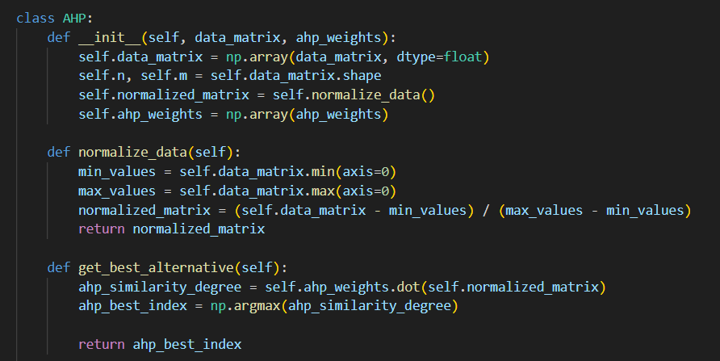
HWNs Network Selection Using AHP
the analytic hierarchy process (AHP) involves:
networks characteristics from four different networks are represented in the form of a data matrix
the data matrix is normalized based on the max and min values from each column.
the normalized matrix is then multiplied with the ahp weights ( which indicate the importance of each input variable).
ranks are given to the values associated with each network present in the resultant matrix.
the network with lowest rank value is selected

Slide 14
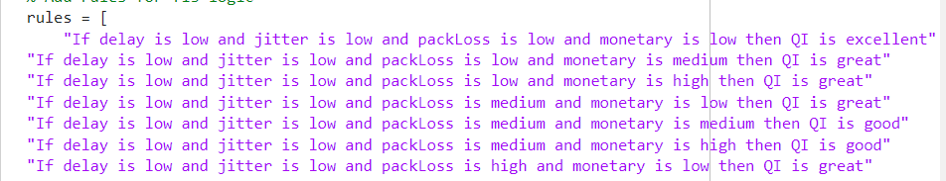
HWNs Network Selection Using Fuzzy Logic
the Fuzzy logic method involves:
fuzzification of inputs with the help of membership function.
fuzzified values are sent to FIS and are processed by using rule base.
the output from FIS (QI) is then sent for ranking.
the network with lowest rank value is select (i.e. highest QI value).

Slide 15
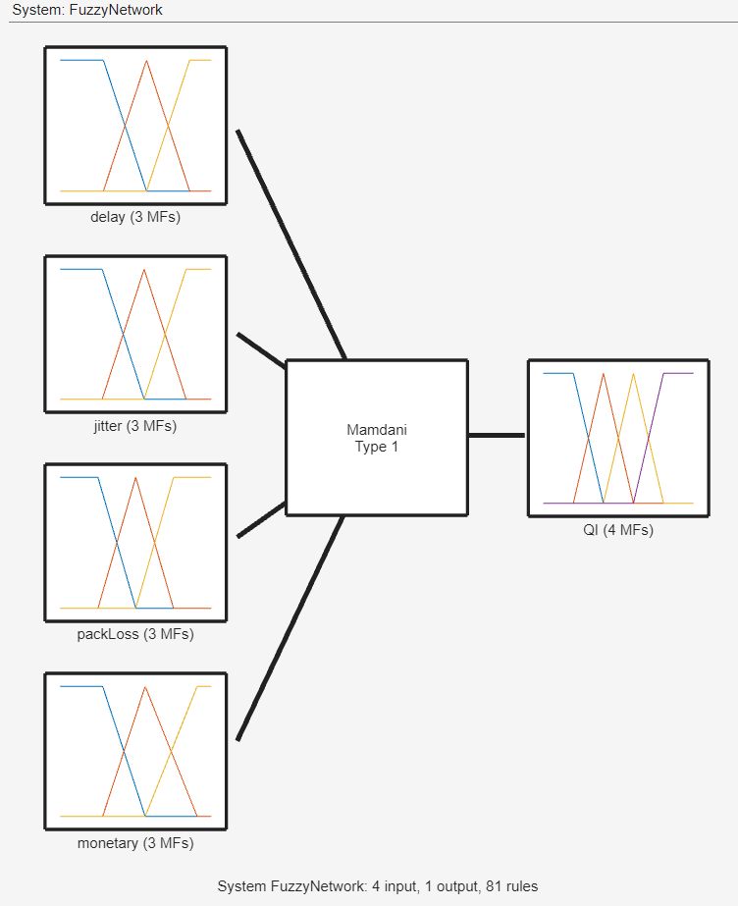
HWNs Network Selection Using Fuzzy Logic

Slide 16
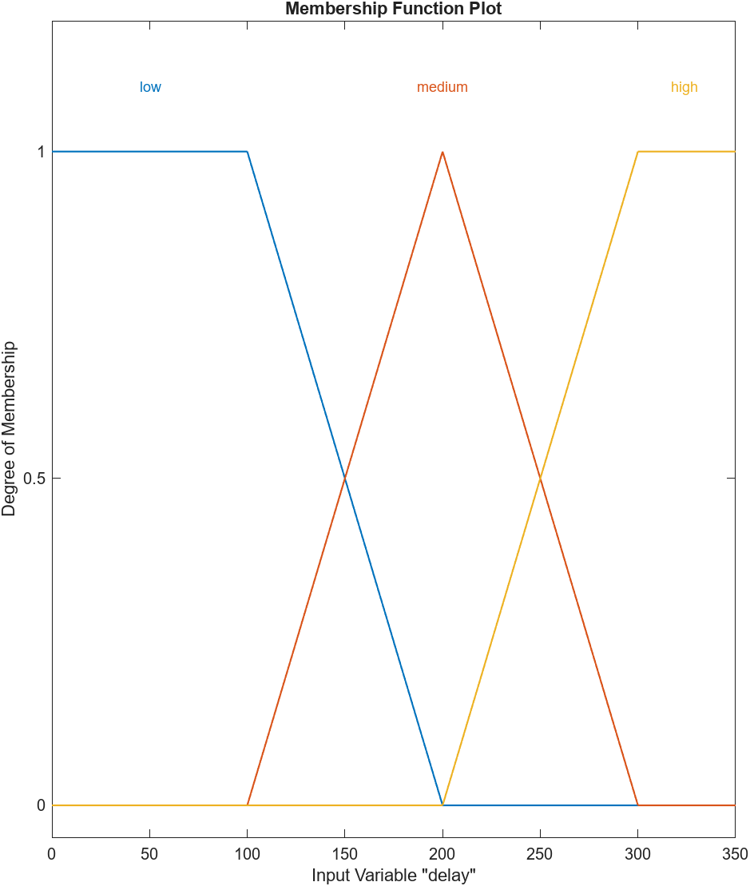
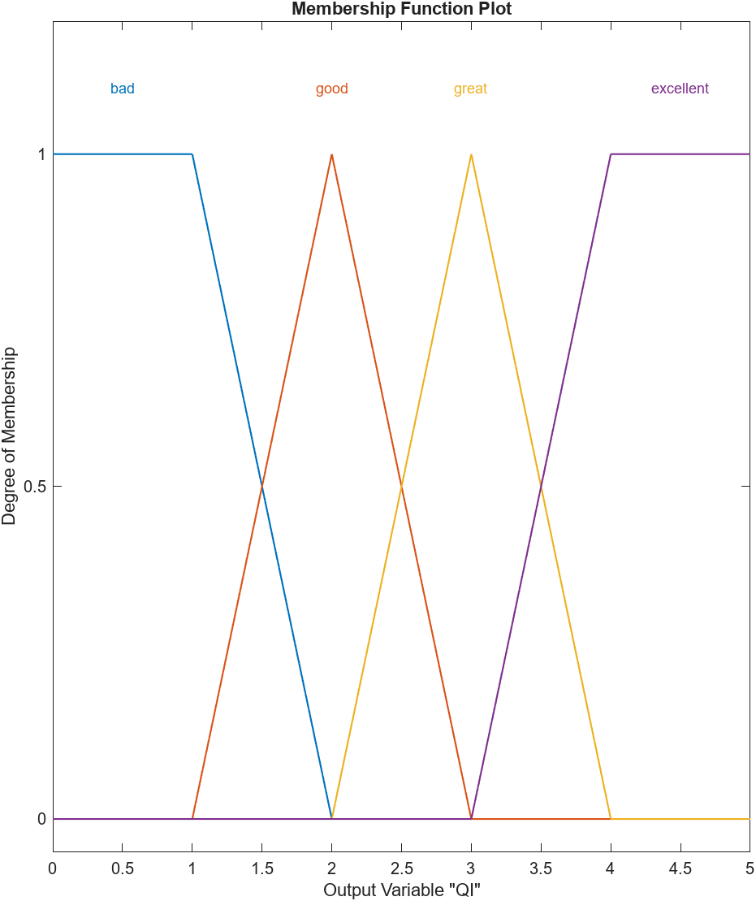
HWNs Network Selection Using Fuzzy Logic

Slide 17
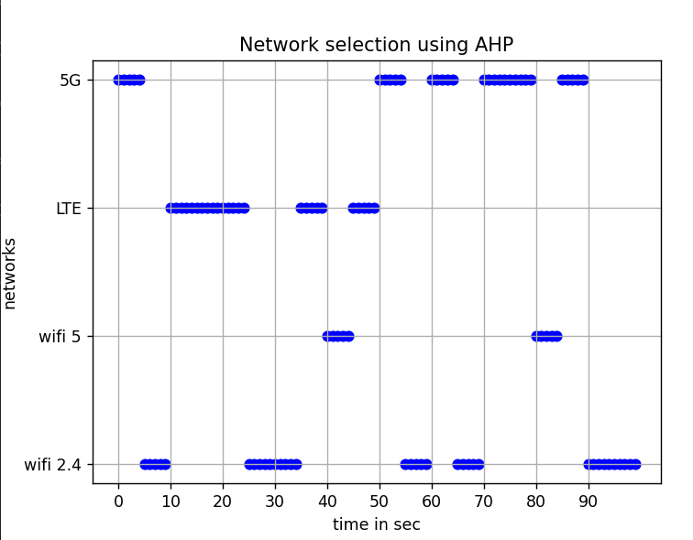
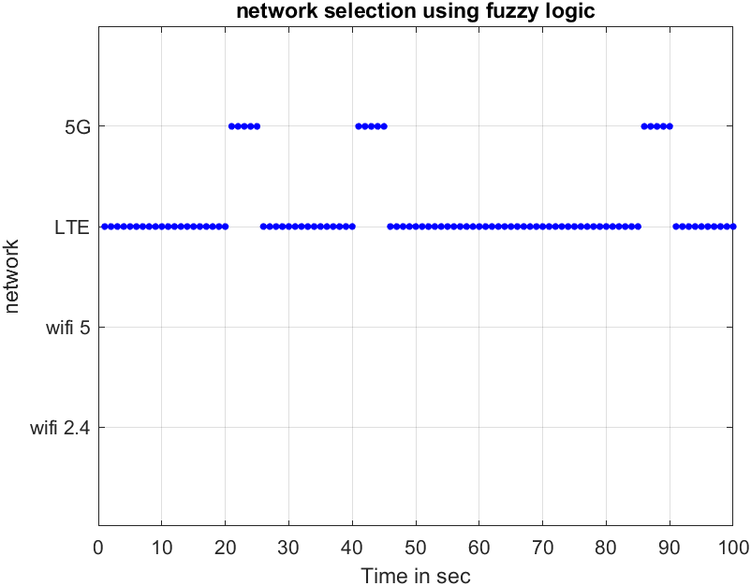
Results AHP vs Fuzzy logic:

Slide 18
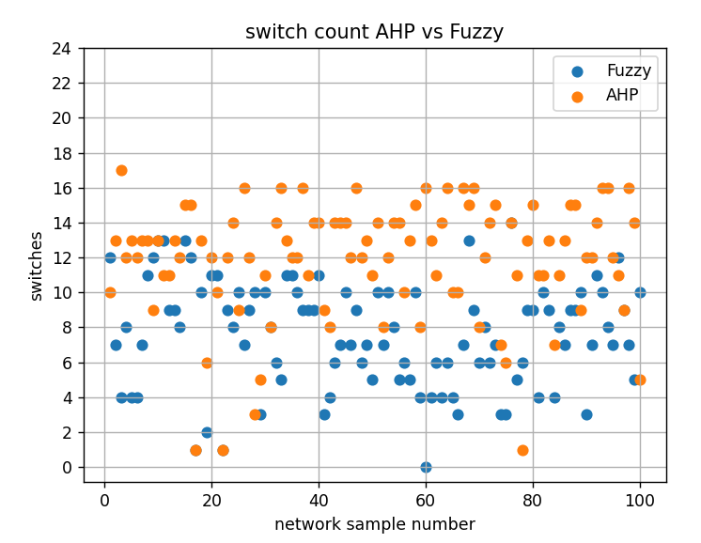
Results AHP vs Fuzzy logic:
Both methods are test over 100 iterations with a 100 different network conditions in each.
In each iteration the number of network switches are collect from each method.
the following figure is plot based the collected data, and it shows that the proposed fuzzy logic based method outperforms the AHP method in most of the iterations.

Slide 19
Simulation - 2

Slide 20
Energy-Efficient Resource Allocation in HWNs
To Simulate Energy-Efficient Resource Allocation in HWNs we have used “MATLAB”
Simulation Parameters -
% Simulation parameters
numAPs = 5; % Number of Access Points
numUEs = 10; % Number of User Equipment's
maxIterations = 100;
% Initialize random system parameters
powerAPs = 10 * rand(numAPs, 1); % Maximum power available at each AP
bandwidths = randi([5, 20], numAPs, 1); % Bandwidths available at each AP
userRequirements = randi([1, 5], numUEs, 1); % Data rate requirements for each UE

Slide 21
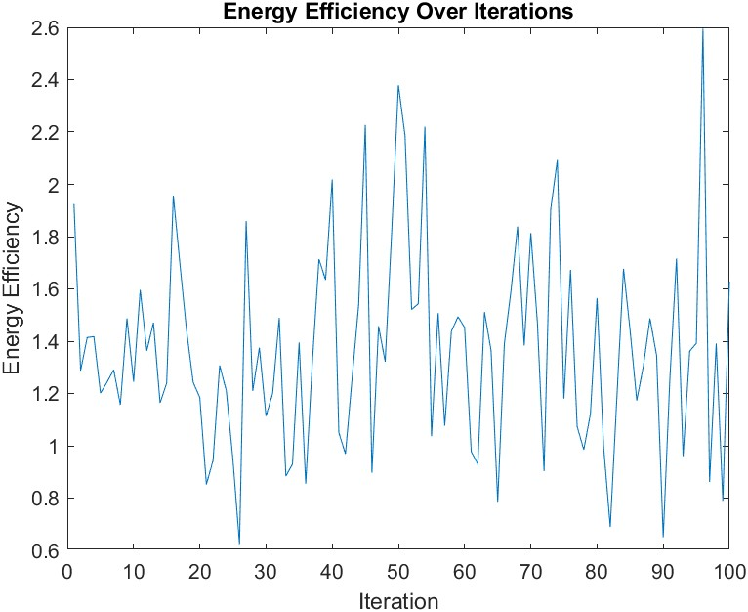

Energy-Efficient Resource Allocation in HWNs
Standard Energy-Efficient Resource Allocation -
The graph illustrates the energy efficiency of a standard resource allocation model over 100 iterations. It displays significant fluctuations in energy efficiency, reflecting inconsistencies in the resource allocation strategy. These irregularities, characterized by high peaks and deep troughs, highlight a lack of stability and predictability in network performance, posing challenges in environments where consistent and reliable service quality is essential.

Slide 22
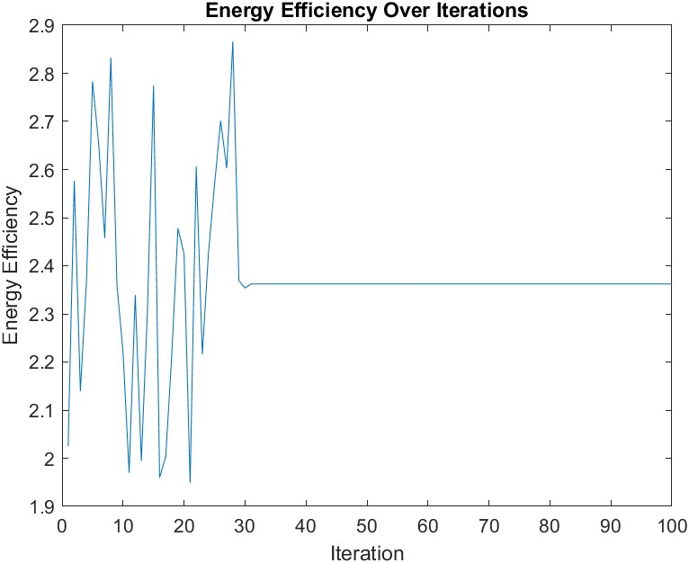
Energy-Efficient Resource Allocation in HWNs
Energy-Efficient Resource Allocation with Feedback Mechanism (Our Implementation) -
The graph displays the performance of an energy-efficient resource allocation model enhanced with a feedback mechanism over 100 iterations. This model utilizes historical data to make informed decisions, significantly improving energy efficiency compared to previous methods. The graph shows a more stable energy efficiency trend with fewer fluctuations, indicating a more predictable and reliable allocation strategy that adapts based on past allocation outcomes to optimize energy use.

Slide 23
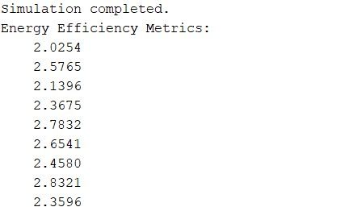

Energy-Efficient Resource Allocation in HWNs
Energy Efficiency Metrics – Simulation Output
Energy Efficiency Metrics
(Before Stabilization)
Energy Efficiency Metrics
(After Stabilization)

Slide 24
Simulation - 3

Slide 25
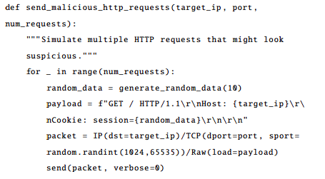
Security in Heterogeneous Wireless Networks
To Simulate the Security in Heterogeneous wireless Networks we have used Kali Linux, Wireshark and Simulation Using Python (Scapy Library)
Generating Malicious HTTP Request -
The script sends a series of HTTP GET requests to a specified target IP address. This type of activity can mimic behavior typical of reconnaissance attacks or attempts to exploit vulnerabilities in web application that might rely on cookie data.

Slide 26
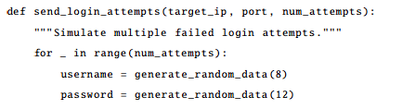
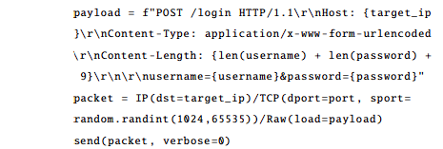
Security in Heterogeneous Wireless Networks
Simulating Login Attempts –
The script sends multiple HTTP POST request aimed at a login endpoint, attempting to simulate a brute-force attack where an threat actor tries various Username and Password combinations to gain unauthorized access.

Slide 27
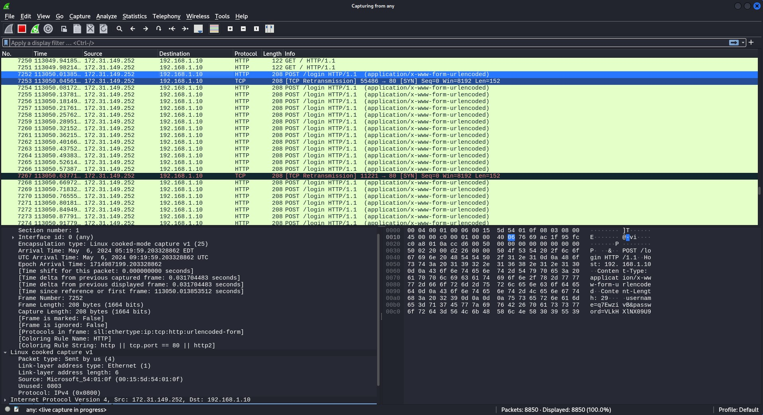
Security in Heterogeneous Wireless Networks
Malicious Traffic Captured by Wireshark –

Slide 28
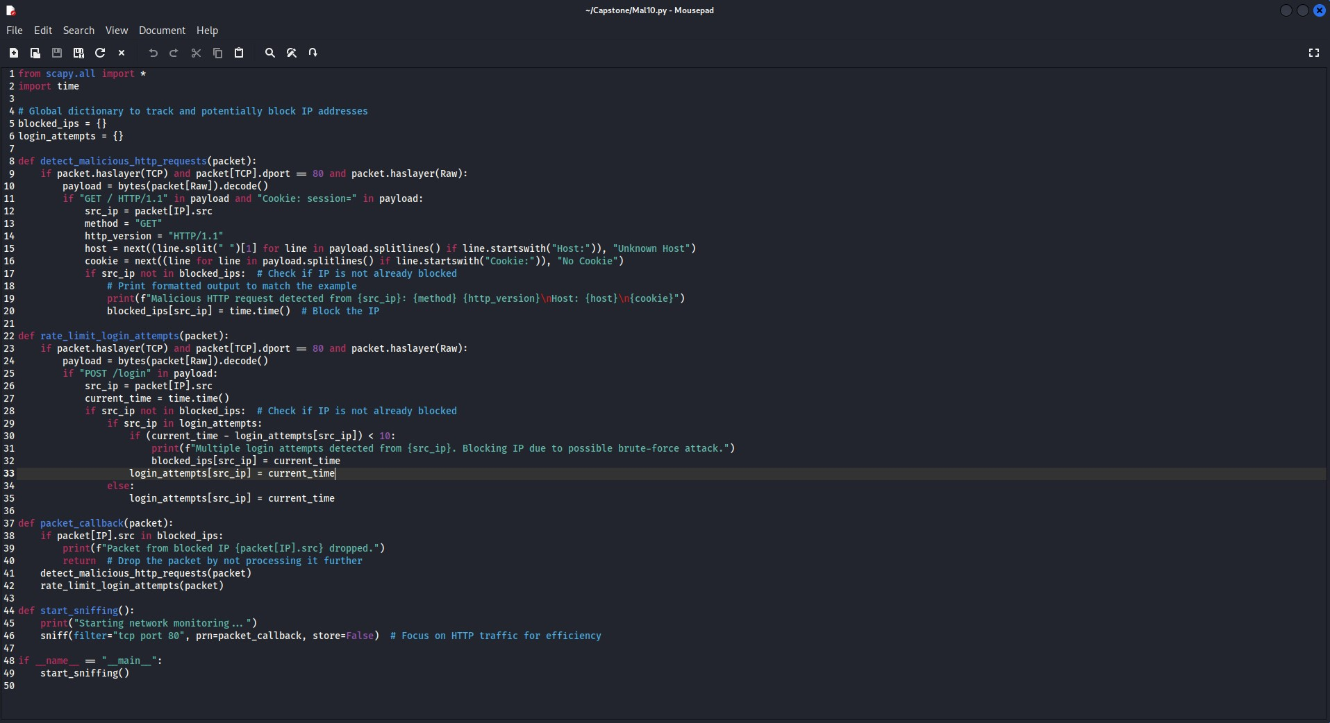
Security in Heterogeneous Wireless Networks
Using Scapy Script to Block Malicious Traffic –

Slide 29
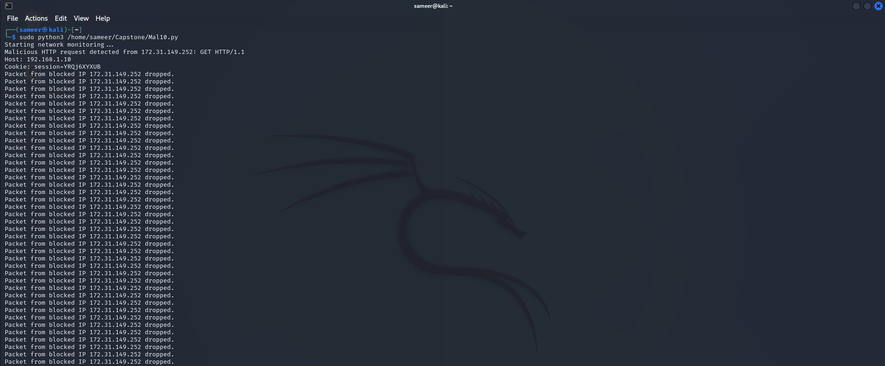
Security in Heterogeneous Wireless Networks
Blocking Malicious Traffic –

Slide 30
Result && Discussion
04
Insights into Heterogeneous Wireless Networks

Slide 31
Network Selection in HWNs
Fuzzy Logic offers a more adaptable and robust approach to network selection in heterogeneous wireless networks. It can reduce the need for frequent switches due to its ability to model uncertainty and accommodate vague inputs. This approach, leveraging fuzzy sets and linguistic variables, allows for more nuanced decisions, optimizing network performance while minimizing disruptive switches. In contrast, Analytic Hierarchy Process (AHP) may require more switches due to its rigid decision-making process, which may overlook subtle variations in network conditions and preferences.

Slide 32
Energy-Efficient Resource Allocation in HWNs
Standard Model vs Feedback Mechanism Model -
The comparison between the standard model and the feedback mechanism model for energy-efficient resource allocation reveals significant differences in performance. The standard model shows greater variability and lower overall energy efficiency across iterations, indicating a lack of stability and predictability in its allocation strategy. In contrast, the feedback mechanism model demonstrates higher and more stable energy efficiency levels. This improvement stems from its ability to use historical data to make informed allocation decisions, which not only enhances energy efficiency but also ensures a more reliable network operation.

Slide 33
Security in HWNs
In Heterogeneous Wireless Networks (HWNs), security management is crucial due to the varied technologies and standards involved. Effective security strategies mitigate risks such as data breaches and unauthorized access across multiple network layers. The integration of advanced encryption protocols, consistent security policy enforcement, and real-time monitoring systems ensures robust defence mechanisms, enhancing the overall security posture of HWNs. These measures are vital for maintaining the integrity and confidentiality of data transmitted across diverse wireless platforms.

Slide 34
Conclusion && Future Works
05
Prospects and Challenges

Slide 35
Conclusion
Heterogeneous Wireless Networks (HWNs) enhance connectivity by integrating multiple wireless technologies, offering improved coverage and increased data throughput. They address the growing demand for seamless mobile services by optimizing resource use and adapting to diverse network conditions. Moving forward, advancing HWN technology will focus on improving energy efficiency, security, and the seamless integration of next-generation wireless systems, ensuring robust and flexible communications infrastructure.

Slide 36
Future Works
Advanced Decision-Making Algorithms
5G and Beyond
IoT and Computing Integration
Security Enhancements

Slide 37
References
06

Slide 38
R. Ferr ´us, O. Sallent, and R. Agust´ı, “Interworking in heterogeneous wireless networks: Comprehensive framework and future trends,” in IEEE Wireless Communications, no. 1, pp. 1-2, April 2010.
[2] F. Bendaoud, M. Abdennebi, and F. Didi, “Network Selection schemes in Heterogeneous Wireless Networks,” Laboratory of Telecommunication Tlemcen (LTT), Technology’s Faculty, Tlemcen’s University, and Laboratory of Processing and Transmission of Information (L2TI), Physics Department, University of North Paris, 2023.
[3] T. Sylla, L. Mendiboure, S. Maaloul, H. Aniss, M. A. Chalouf, and S. Delbruel, “Multi-Connectivity for 5G Networks and Beyond: A Survey,” in Sensors, vol. 22, pp. 1-32, October 2022.

Slide 39
C. Monteiro, V. Rios, and P. R. L. Gondim, “Use of Fuzzy Logic for Networks Selection in Heterogeneous Wireless Environment,” in Proceedings of the International Conference on Advanced Communication Technology (ICACT), February 2012.
R. Liu, M. Sheng, and W. Wu, “Energy-Efficient Resource Allocation for Heterogeneous Wireless Network With Multi-Homed User Equipments,” IEEE Access, 2018.
Y. Zhang, J. Chen, and X. Wang, “Security-Aware Cross-Layer Resource Allocation,” IEEE Transactions on Mobile Computing, 2023.
A. Monteiro, E. Souto, R. Pazzi, and M. Nogueira, “Context-aware network selection in heterogeneous wireless networks,” Computer Communications, vol. 135, pp. 1–15, 2019

Slide 40
Thank You!!

